Slide 1
Pair Programming
Discussion
By Alex Howson

Slide 2
Agenda
01. Pair Programming
02. Methodologies
An introduction into pair programming
The means by which pair programming can be carried out
03. Benefits
04. Drawbacks
05. Discussion
Benefits I have witnessed with pair programming from first-hand experience
Drawbacks I have witnessed with pair programming from first-hand experience
Discussion about pair programming and where we might want to consider using it

Slide 3
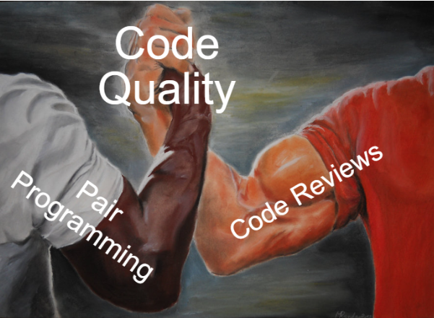
Pair Programming
Pair programming is a process of discovery and problem-solving working towards a solution for a valuable business need whilst writing high quality code.

Slide 4
Roles
Roles
Driver – The person writing the code asking the design questions
Navigator – The person leading the design and answering the design questions from the driver

Slide 5
Methodologies Pomodoro
Pomodoro
Pomodoro is a time-based means of pair programming. The role switching occurs after a certain time limit.
Benefits
- Good for tracking when to take breaks from development
Drawbacks
- Forgetting to set or going past the timer leading to fixed driver/ navigator roles.
- Context switching at disruptive points during the pairing

Slide 6
Methodologies Ping Pong
Ping Pong
Ping pong is a context means of pair programming. The role switching occurs after a passing unit test when using a test-driven approach.
Benefits
- Good for tracking when to switch roles
- Less disruptive when switching roles
Drawbacks
- Not good for tracking when to take breaks
Notes:
Personal favourite approach

Slide 7
Benefits
Live Code Review
One of the main benefits of pair programming is this idea of a “live code review”. Whether pairing eliminates the need for code reviews is another discussion. Decisions are made “Just In Time” through pairing when problem solving. Rather than this being an individual process a consensus is reached for Path A/ B/ C in the design direction. It can also lead to a “nowhere to hide” culture when it comes to code quality in a competent pair; this leads to a lack of corners being cut in the design process.
Learn From Coworkers
Pair programming provides an excellent opportunity to learn from one another. Experienced developers can learn fresh approaches, junior developers have the potential of learning the ropes faster. Pairing is also good for learning new areas of a codebase and its domain. This breaks down knowledge silos and single points of failure within the team.
Increase Team Cohesion
Each developer brings their own perspective, approach and point of view to the main job of software development which is problem solving. These unique approaches can create friction within especially new teams if left unchecked. Pair programming confronts this head on and forces co-operation and understanding to different ways of approaching/ solving problems as well as ways of working. “Speedback” is a good means of dealing with grievances between team members during the initial adoption of pairing.

Slide 8
Drawbacks (Enforced)
Inflexible Work Schedule
One of the downsides to pair programming is it doesn’t promote any degree of flexibility in a working schedule. This creates difficulties with organising away from desk errands and other life responsibilities/ distractions that disrupt the pair when it is an enforced way of working.
Trio + Pairing
When pairing extends to three or more developers the third developer’s role is undefined. The best usage I have seen for the third + role is to join a group temporarily to help settle a debate in design direction or to provide a third opinion in design direction.
Past this however a third + developer in the pair often becomes a passive code quality spectator at best and at worst waste to the development effort.
Tiredness
Pairing is a tiring way of working. Even with constructive approaches in the code discovery process there is still far more discussion and thought into design that would normally be more automated.

Slide 9
Drawbacks
Untrusted Pairing Groups
In teams where trust is an issue pair programming can start to form some nasty restrictions around whom can pair with whom. This team mindset forms out of trusted and untrusted individuals within a team extending to the pairing groups.
Gatekeeping who can and can’t pair isolates individuals and pairs, creates distrust within the team and is ultimately unproductive to the goal of delivery. Untrusted pairs/ individuals is a team issue and the support for the individual/ pair needs to be provided (they were hired for a reason) e.g coding standards training etc.
Comfortable Pairing Groups
Comfortable pairing groups of colleagues that get along will occur. It is important when this pattern starts to form to address it to ensure the “mixing pot” approach to different culture and approaches to get the most out of the pair programming methodology.
Notes:
Team safety can be improved using the 1 – 5 anonymous scoring system before the start of ceremonies. The number 5 represents high team safety the number 1 represents low team safety. Meetings get cancelled on 1 or 2s and considerations for how the team improves team safety need to be considered. If this happens consistently a code freeze needs to be considered.

Slide 10
Drawbacks
Unproductive Design Debates
Discovery is at the heart of pair programming and during this discovery process roadblocks will be hit. Between the driver and navigator roles it is important to stop, think and discuss the next potential move for the pair in the design direction.
This can lead to endless unproductive debate. Here are some strategies to consider
Bring in a temporary third member for a third opinion on potential solutions
Organise a mob workshop to get a team opinion on potential solutions
Agree to disagree but remain open to each other's ideas.
Commit at the point of the disagreement
Branch off try person A’s solution if it works continue
If person A’s solution didn’t work reset to the commit and try person B’s solution
This will help ensure that the pair can continue and in future the two team members can still work together. Importantly don’t make the debates personal.

Slide 11
Discussion

